Slide 1
Diagnosis of acid base balance in diarrhoeic calves.
Implementation in practice
Dai Grove-White

Slide 2
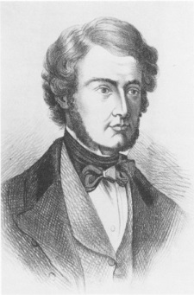
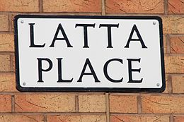
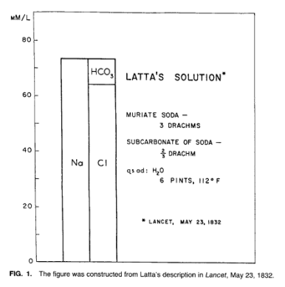
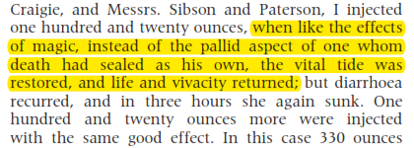
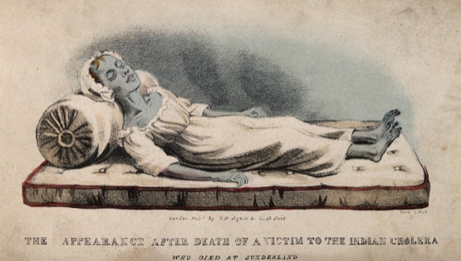
A historical perspective
William O’ Shaughnessy 1831
  “I would expect much benefit from the frequently repeated use of the neutral salts by the mouth dissolved in large quantities of tepid water. In severe cases, in which absorption is totally superseded I would not hesitate to inject some warm water into the vein. I would also, without apprehension, dissolve in that water the mild innocuous salts which Nature herself is accustomed to combine with human blood and which in cholera are deficient.”
Thomas Latta 1832 – first account of IV fluids in cholera patient
Sidney Ringer – ‘Ringer’s fluid’ 1880
James Gamble & Daniel Darrow - 1930s onwards
WHO 1985 “Oral rehydration therapy is the most important medical advance of the 20th century.”

Slide 3
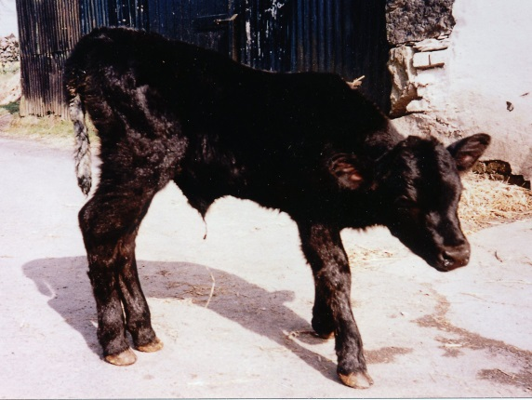
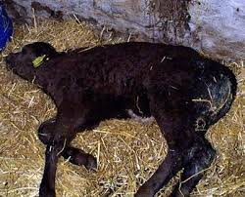
Neonatal calf diarrhoea
Major cause of morbidity & mortality in calves <3 weeks old
Multifactorial
  pathogens (pathogen load: “hygiene/sanitation”)
    ETEC
    viruses
      rotavirus
      coronavirus
    Cryptosporidium parva
    others
  host factors
    colostrum
    nutrition etc

Slide 4
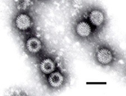
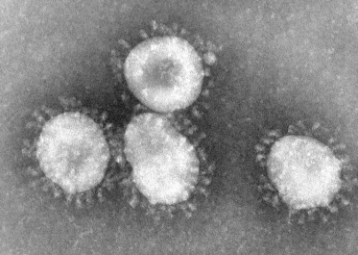
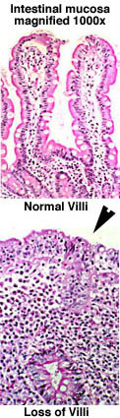
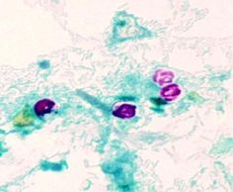

Pathophysiology of diarrhoea in calves
First described in 1970s & 80s
  Tennant
  Bywater & Logan
  Fisher
  Argenzio
Aetiologic agents & pathology described during same period
hypovolaemia, & haemoconcentration
  loss of water & electrolytes
acid-base disturbances
  Respiratory acidosis – reduced lung perfusion (hypovolaemia)
  metabolic acidosis.
    Loss of bicarbonate into gut
    colonic fermentation – D-lactate (calves > 6 days old)
    reduced tissue perfusion – D & L lactate
hyponatraemia
  body conserving water at expense of [Na⁺]
hyperkalaemia
  intracellular buffering) shift of K⁺ from cells into plasma
pre-renal failure

Slide 5
Meanwhile in the field ……..
up until 1970’s – tentative use of oral fluids as “supportive therapy” for antibiotics.
1970’s - 1980’s – veterinary ORS fluids based on WHO model (Bywater, Tennant)
uptake slow initially…….. (still “supportive”)
IV therapy – advocated by J.G. Watt in 1965
  not adopted due to practical difficulties

Slide 6
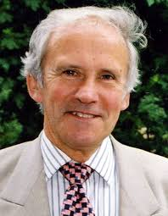
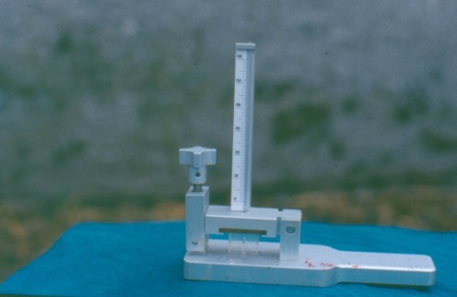
Michell & Groutides 1990’s
Investigated pathophysiology of calf diarrhoea using experimental infections with ETEC
  described changes associated with death or survival
    metabolic acidosis
    hypovolaemia
    hyperkalaemia
validated the Harleco apparatus for evaluation of acid-base status from venous blood
    Van Slyke method
      CO₂ liberated from HCO₃⁻ in whole blood
      direct measure of metabolic acidosis
    hand held
    suitable for field use

Slide 7
Signs of acidosis.
Life is a struggle not against sin, not against money power but against hydrogen ions. The healthy man is one in whom these ions, as they are dissociated by cellular activity, are immediately fixed by alkaline bases. The sick man is one in whom the process begins to lag with the hydrogen ions getting ahead. The dying man doesn’t struggle much and he isn’t much afraid. As his alkali gives out he succumbs to a blest stupidity. His mind fogs. His willpower vanishes. He scarcely gives a damn. HL Mencken 1919
very non-specific signs in calves – ataxia followed by recumbency !

Slide 8
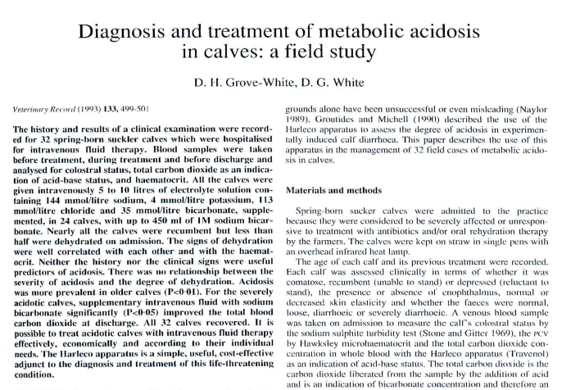

1993 - 1st use of the Harleco apparatus in the field –case series (n=32) of hospitalised calves
Harleco was suitable for practice
metabolic acidosis
  widespread and very severe
    not associated with dehydration
    specific therapeutic target
100% Recovery rate

Slide 9
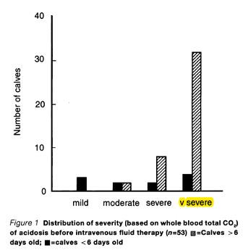
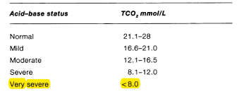
Subsequent work
larger case series over 3 years
  intensive sampling during therapy
  full electrolyte panel
  standardised therapeutic regime based on Harleco
outputs
  development of an IV protocol based on Harleco measurements
    high treatment success
    age difference in acidosis severity
    calves > 6d old – more severe & high anion gap
      colonic fermentation ?
      cannot accurately estimate BIC requirements
C_{orn}TCO₂ = 4.9 +1.1*H_{arl}TCO₂

Slide 10
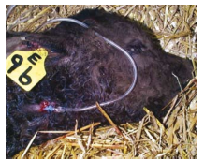
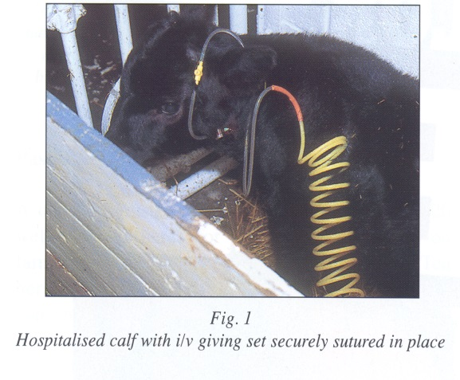
which led to ……….
“roll out” into the field
  rational use of ORS
  wide adoption of IV therapy by practitioners
    metabolic acidosis as a therapeutic target
      Harleco – but sales discontinued by 2000
      age distribution and clinical signs

Slide 11

Current options for field assessment of acid base disturbances.
Hand held point-of-care devices e.g. iSTAT
pH meters
  no discrimination as to type of disturbance
currently working on “harleco like” apparatus
  plastic
  cheap
  solar powered shaker (Stage 2)
  medical application in resource-poor settings
    acute malaria ?

Slide 12
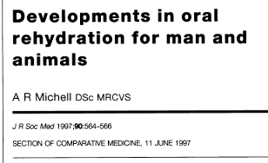
“The essence of comparative medicine is the similarity between species and the lessons to be learned from the differences between them”
AR Michell J R Soc Med 1997
infants
calves
Lo Na ORS
metabolic acidosis
  moderate – severe
  primarily hyperchloraemic
IV Therapy
  volume expansion only
    MA corrected by kidneys
Hi Na ORS
metabolic acidosis
  age differences
    moderate – severe (< 6d old)
    very severe (> 6d old)
  high Anion Gap acidosis
    colonic fermentation
IV therapy
  <6d volume expansion only
  >6d volume expansion & bicarbonate
    AVD 1-2.4 (normal range 0.3 – 0.5)

Slide 13
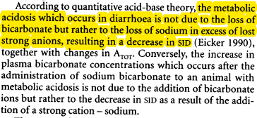

Acid-base theories
Henderson Haslebach approach
Stewart’s Strong ion difference (SID)
Bicarbonate buffer system
metabolic acidosis:
  reduction in [HCO₃⁻]
  unrelated per se to [Na⁺ ]
Na balance (Michell 1989)
  Na – “osmotic skeleton”
  hyponatraemia
    due to“water retention in defence of plasma volume”
Anion Gap = Na⁺ + K⁺ - Cl⁻ - HCO₃⁻
SID = Na⁺ + K⁺ - Cl⁻
Acidosis – fall in SID

Slide 14
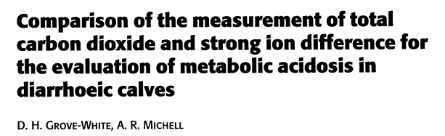
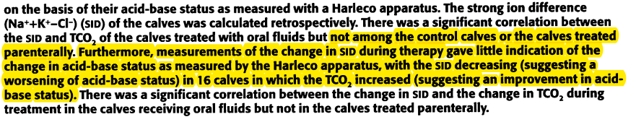
Bob Michell and SID !
“Application of the strong ion approach to acid-base disturbances in 231 sick calves with or without diarrhea indicated that acidemia was due predominantly to a strong ion acidosis in response to hyponatremia accompanied by normochloremia or hyperchloremia (Constable 2005)”
“Classic” interpretation – metabolic acidosis & hyponatraemia (independent )
Vet Rec 2001

Slide 15

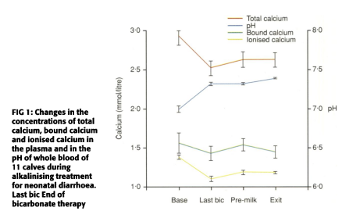
Iatrogenic hypocalcaemia
clinical hypocalcaemia observed & treated during IV alkalinising therapy
…. small case study
demonstrated significant fall in ionised Ca⁺⁺ during therapy
  pH dependant binding of Ca⁺⁺
  risks associated with bicarbonate therapy
Vet Rec 2001

Slide 16
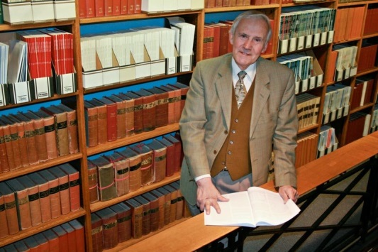
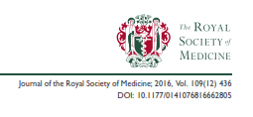
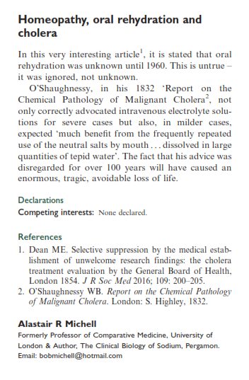

Slide 17
Acknowledgements
All who were involved in Bob’s group at the RVC:
  Christos Groutides
  David White
  Harriet Brooks
  Tony Wagstaff
  Norbrooks Pharmaceuticals
  Pauline Michell

